Slide 1

On the Generalization and Personalization Tradeoff in Agentic AI Networks
Xubo Li∗, Yong Xiao ∗ § ¶, Yingyu Li‡
∗School of Elect. Inform. & Commun., Huazhong Univ. of Science & Technology, Wuhan, China
§Pengcheng National Laboratory, Shenzhen, China
¶Pazhou Lab, Guangzhou, China
‡School of Mech. Eng. and Elect. Inform., China University of Geosciences, Wuhan, China
IEEE GLOBECOM’25
Notes:
Hello everyone, I’m Xubo Li from Huazhong University of Science and Technology.
This work is co-authored with Yong Xiao from Huazhong University of Science and Technology, and Yingyu Li from China University of Geosciences.
I’m glad to share my recent work with you here.
The topic of my presentation is On the Generalization and Personalization Tradeoff in Agentic AI Networks.
（0.5min）

Slide 2
Outline
Background and Motivation
System Model & Problem Formulation
Workflow of MAN
Theoretical & Experimental Results
Conclusions
Notes:
My presentation will cover the following five aspects: first I will introduce the background and motivation of my research. Second, is the system model and problem formulation. Third, I will introduce the workflow of MAN, and then is the theoretical and simulation results, last is conclusions.

Slide 3
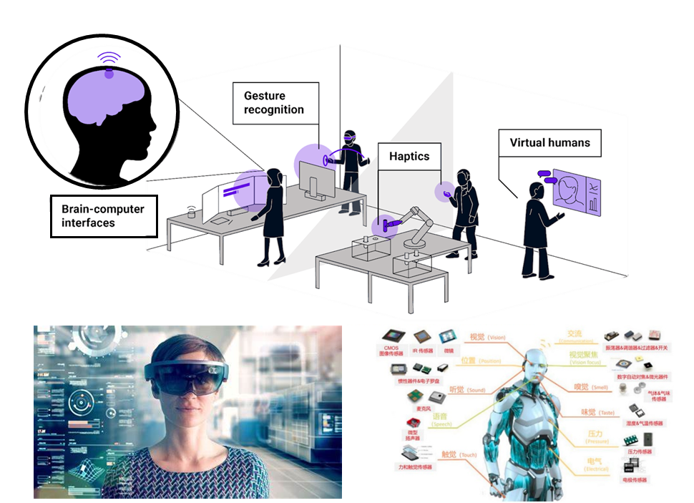
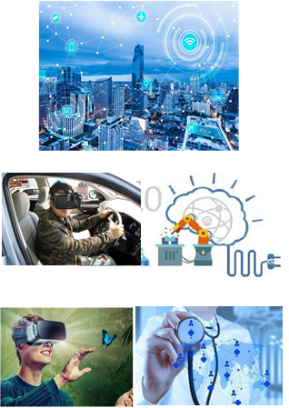





Background
Digital Twin
Agentic AI Networking
eMBB
URLLC
mMTC
AI + Communication Networks:
Passive learning framework
AI-induced network congestion
Data privacy leakage risk
Without performance guarantee
Mobile Internet
6G
Voice + Text
Voice
2030’s
5G
AI in Net
4G
2020’s
Agentic AI Networks (AgentNet):
Efficiency
Guaranteed performance
Proactivity
Interaction
3G
AI on Net
Perceive dynamic environments
Execute autonomous decision-making
Refine operational strategies via continuous collaboration
2010’s
2G
2000’s
Inefficiency
Limited applications
1G
AI and Net
1990’s
Without performance guarantee
1980’s
Notes:
With the increasing proliferation of AI-based solutions in various parts of telecommunication networks, the next generation mobile systems, will be largely defined by a complex ecosystem consisting of diverse AI-based functions, models, and applications.
However, existing solutions still based on a passive learning framework, and often adopted a centralized scheme, which may lead to privacy leakage and network congestion.
Agentic AI networking can perceive dynamic environments, execute autonomous decision-making, and refine operational strategies via continuous collaboration. Thus, it has attracted significant interest from both industry and academia.

Slide 4
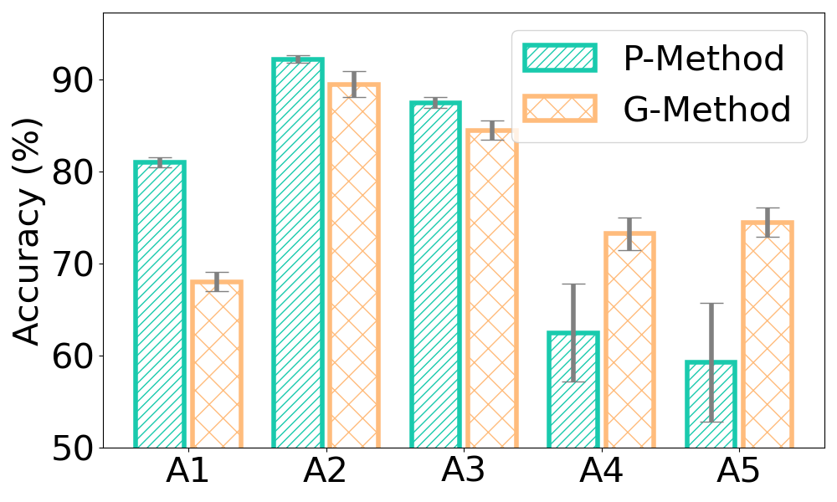
Motivation
Two critical metrics for agentic AI networking:
Generalization: ensures each agent can apply previously learned knowledge or skills across diverse, unseen tasks and environments.
Personalization: allows the agent to tailor its behavior, responses, or decision-making to individual users’ personal preferences.
Seen Agents
Unseen Agents
* A1 represents Agent 1, and so on
Generalization
Personalization
Conflict
How can we effectively balance the tradeoff between generalization and personalization in agentic AI networking?
Notes:
Generalization and personalization are two critical metrics for AgentNet because they collectively determine the system’s overall adaptability and user-centric effectiveness.
Generalization ensures each agent can apply previously learned knowledge or skills across diverse, unseen tasks and environments. Personalization allows the agent to tailor its behavior, responses, or decision-making to individual users’ personal preferences.
At this point, a crucial issue emerges, How can we effectively balance the tradeoff between generalization and personalization in agentic AI networking?

Slide 5
Key Contributions
Propose a meta learning-based agentic AI networking framework (MAN) to strike an effective balance between global generalization and local personalization
Derive asymptotic theoretical bounds for generalization and personalization errors of MAN respectively
Conduct extensive measurements on real-world dataset to demonstrate that proposed MAN can improve the tradeoff between personalization and generalization in various environments and application scenarios.
Notes:
Here are the key contributions of this work.

Slide 6
Outline
Background and Motivation
System Model & Problem Formulation
Workflow of MAN
Theoretical & Experimental Results
Conclusions
Notes:
Next I will introduce the system model and problem formulation of our work.

Slide 7
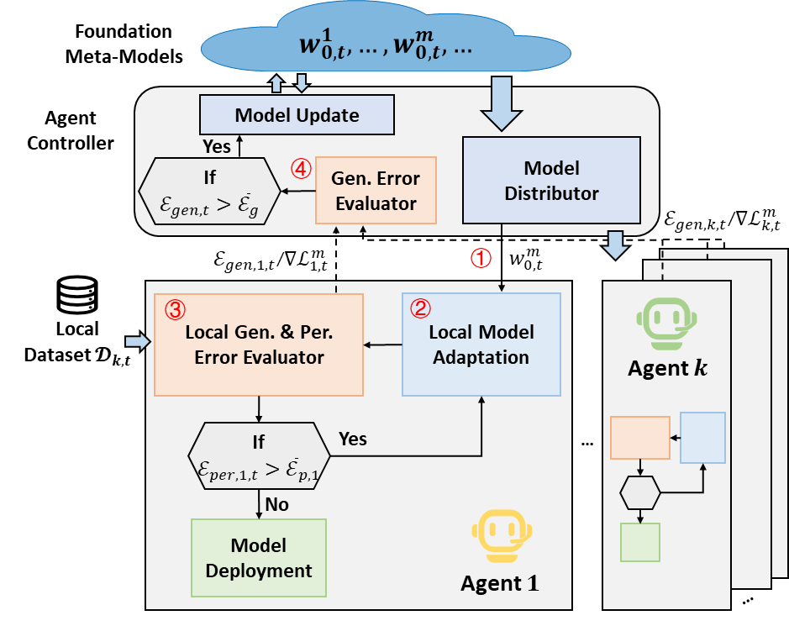
System Model
MAN Architecture
Foundation models are deployed at the cloud targeting at different tasks and constructed and maintained by all agents for better generalization capability.
The environment of each agent change with time.
Each agent finetune the meta-model according to its local dataset to enhance the personalization performance.
Notes:
I will introduce the system model first.
Foundation meta-models are deployed at the cloud targeting at different tasks and constructed and maintained by all agents for better generalization capability.
Each agent aims to finetune the meta-model according to its local dataset to enhance the personalization performance.
We emphasize that the environment of each agent change with time.

Slide 8
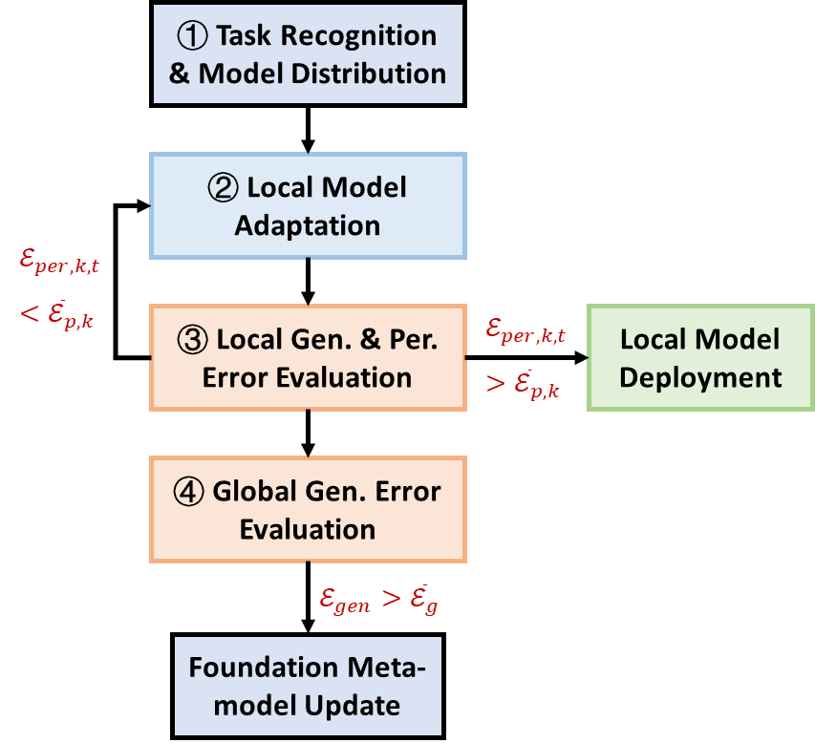
System Model
MAN Architecture
Key Procedures
Notes:
The key procedures are shown on the right.
First, the agent controller will identify the task handled by each agent, and distribute the corresponding pre-trained meta-model for it based on its task.
Second, upon receiving the meta-model, the agent performs local adaptation.
Third, during this process, continuously evaluate the personalization and generalization errors. Once the personalization error meets the requirement, it’s ready for deployment.
Finally, the agent controller assesses the global generalization error. Once the requirements are not met, the meta-model will be updated.

Slide 9
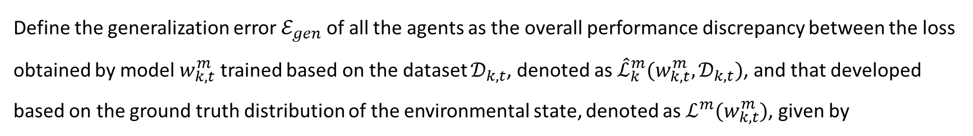
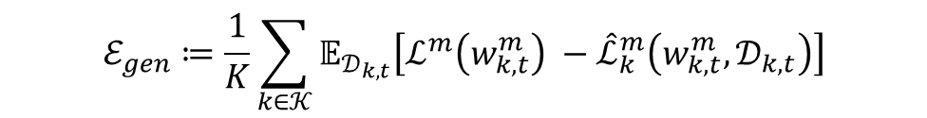
Problem Formulation
Definition1 (Generalization Error)
Define the generalization error $ℰ_{gen}$ of all the agents as the overall performance discrepancy between the loss obtained by model $w_{k,t}^{m}$ trained based on the dataset $𝒟_{k,t}$, denoted as ${\hat{ℒ}}_{k}^{m}(w_{k,t}^{m},𝒟_{k,t})$, and that developed based on the ground truth distribution of the environmental state, denoted as $ℒ^{m}(w_{k,t}^{m})$, given by
$$ℰ_{gen}≔\frac{1}{K}\sum_{k∈𝒦}{𝔼_{𝒟_{k,t}}\left[ℒ^{m}\left(w_{k,t}^{m}\right) −{\hat{ℒ}}_{k}^{m}\left(w_{k,t}^{m},𝒟_{k,t}\right)\right]}$$
*Notation: $m$ - index of task; $k$ - index of agent; $t$ - time slot
To improve generalization performance, it requires to learn common patterns and features from a wide range of diverse datasets
Notes:
Before we formulate the problem, let us first introduce the definition of generalization and personalization errors.
Generalization error is defined as the average value of the discrepancy between the empirical error and the population error obtained by each agent’s local model.
From the definition, we can observe that to improve generalization performance, it requires to learn common patterns and features from a wide range of diverse datasets.

Slide 10
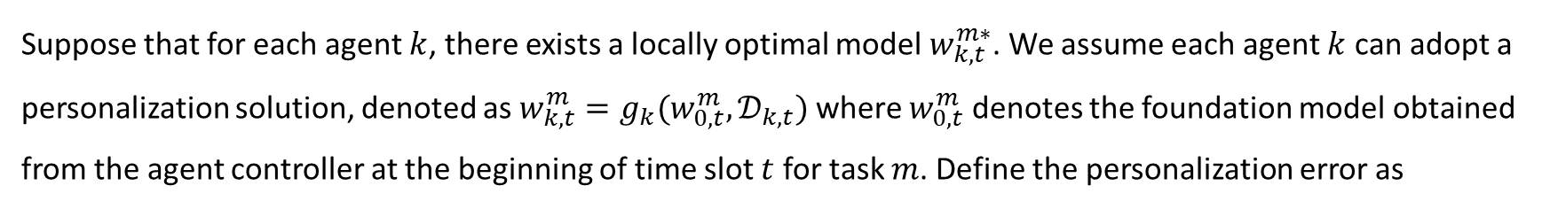
Problem Formulation
Definition2 (Personalization Error)
Suppose that for each agent $k$, there exists a locally optimal model $w_{k,t}^{m∗}$. We assume each agent $k$ can adopt a personalization solution, denoted as $w_{k,t}^{m}=g_{k}(w_{0,t}^{m},𝒟_{k,t})$ where $w_{0,t}^{m}$ denotes the foundation model obtained from the agent controller at the beginning of time slot $t$ for task $m$. Define the personalization error as
$$ℰ_{per}≔\left\|ℒ_{k}^{m}\left(w_{k,t}^{m∗}\right)−ℒ_{k}^{m}\left(g_{k}(w_{0,t}^{m},𝒟_{k,t})\right)\right\|$$
*Notation: $m$ - index of task; $k$ - index of agent; $t$ - time slot
To enhance the personalization capability, it requires the model focus on the unique preferences and personalized behaviors of a single agent.
Notes:
Personalization error is defined as performance gap between the local model obtained by finetuning the foundation meta-model and the locally optimal model.
To enhance the personalization capability, it requires the model focus on the unique preferences and personalized behaviors of a single agent.

Slide 11

Problem Formulation
Main Objective
To construct task-oriented models that minimize their local task-specific losses and at the same time ensure both generalization and personalization errors are below tolerable levels, we formulate the optimization problem as:
$$\min_{w_{k,t}^{m}}{{\hat{ℒ}}_{k}^{m}\left(w_{k,t}^{m},𝒟_{k,t}\right)}, ∀k∈𝒦$$
s.t. $ℰ_{gen}≤{\overline{ℰ}}_{g}$ and $ℰ_{per}≤{\overline{ℰ}}_{p}$
Maximum tolerable levels of gen. and per. errors
Notes:
Based on the two definitions, the main objective is to develop a unified AgentNet architecture for all agents that minimize their local task-specific losses and at the same time ensure both generalization and personalization errors are below tolerable levels.

Slide 12
Outline
Background and Motivation
System Model & Problem Formulation
Workflow of MAN
Theoretical & Experimental Results
Conclusions
Notes:
Then, we will present the workflow of MAN.

Slide 13
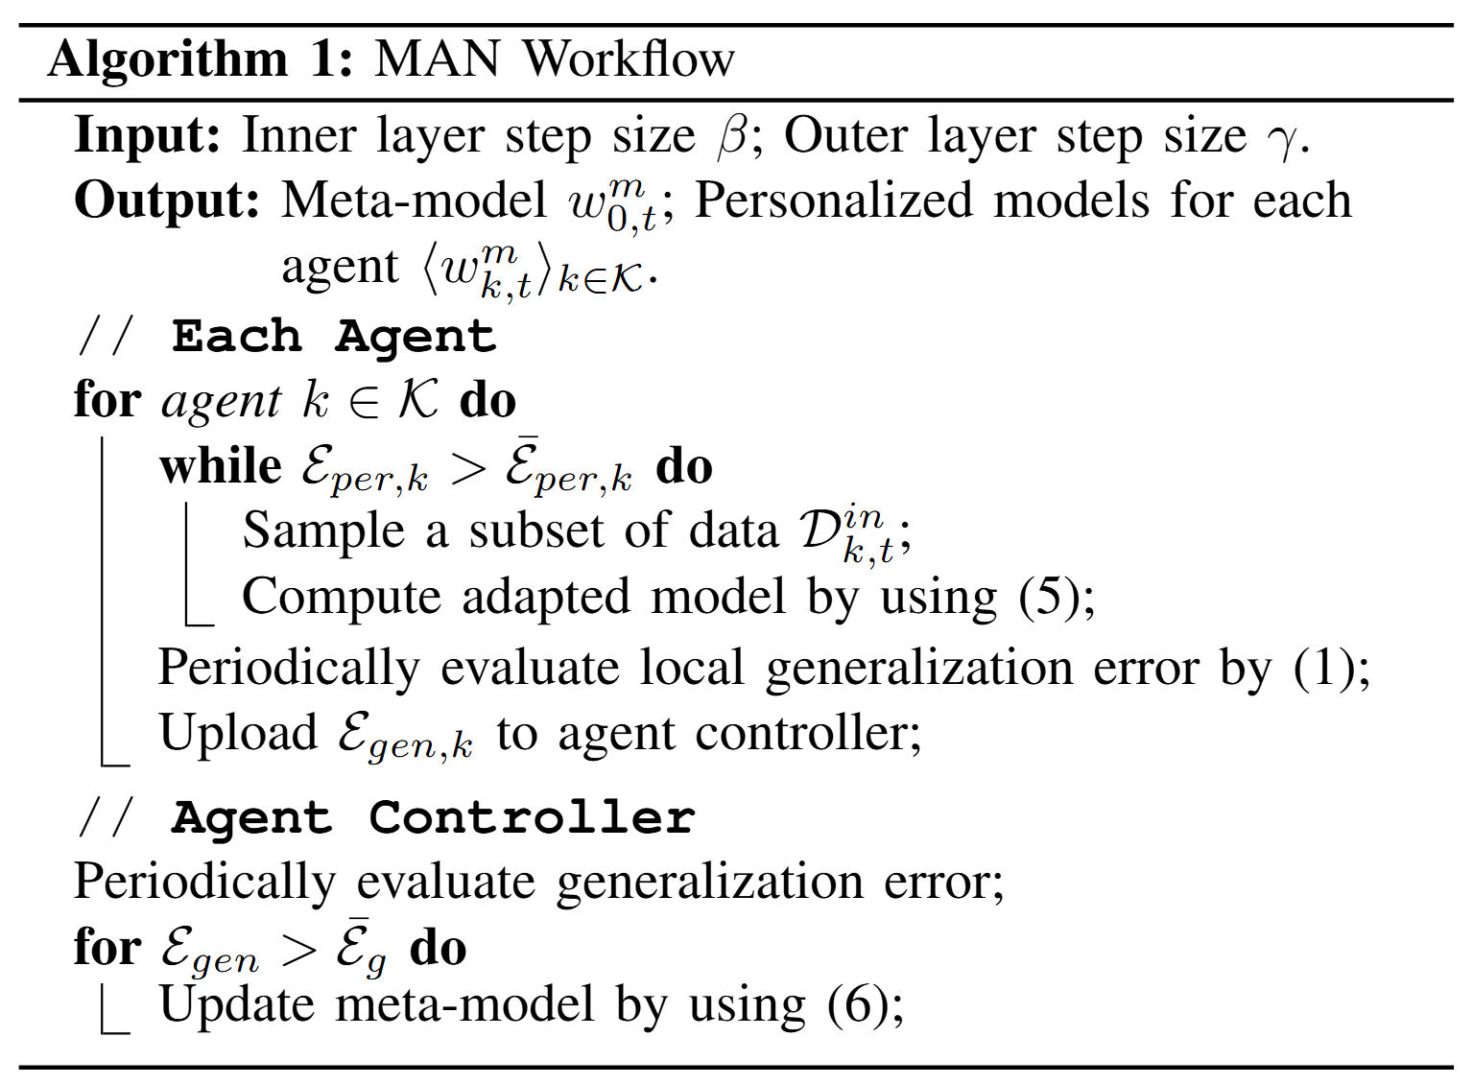
Workflow of MAN
Notes:
As previously discussed, the key procedures has been introduced.
So In this section, I will mainly focus on how the model is updated.

Slide 14
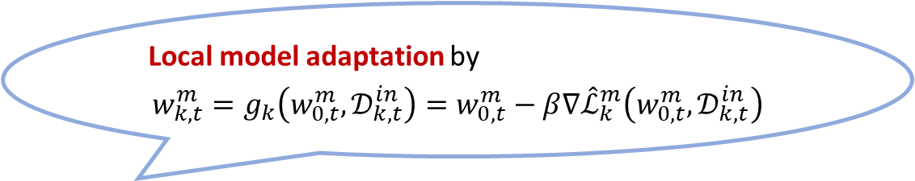
Workflow of MAN
Local model adaptation by
$$w_{k,t}^{m}=g_{k}\left(w_{0,t}^{m},𝒟_{k,t}^{in}\right)=w_{0,t}^{m}−β∇{\hat{ℒ}}_{k}^{m}\left(w_{0,t}^{m},𝒟_{k,t}^{in}\right)$$
Notes:
Upon receiving the meta-model, the agent finetune the meta-initialization via several steps of stochastic gradient descent to obtain a personalized local model.
During this process, continuously evaluate the personalization and generalization errors. Once the personalization error meets the requirement, it’s ready for deployment.

Slide 15

Workflow of MAN
Local model adaptation by
$$w_{k,t}^{m}=g_{k}\left(w_{0,t}^{m},𝒟_{k,t}^{in}\right)=w_{0,t}^{m}−β∇{\hat{ℒ}}_{k}^{m}\left(w_{0,t}^{m},𝒟_{k,t}^{in}\right)$$
Meta-model optimization by
$$w_{0,t}^{m}\underset{←}{}w_{0,t}^{m}−\frac{γ}{K}∇{\hat{ℒ}}_{k}^{m}\left(w_{k,t}^{m},𝒟_{k,t}^{out}\right)$$
Notes:
The agent controller periodically assesses the global generalization error. Once the requirements are not met, the meta-model will be updated by collecting the latest gradients of the local models of all the agents that are sharing this task.

Slide 16
Outline
Background and Motivation
System Model & Problem Formulation
Workflow of MAN
Theoretical & Experimental Results
Conclusions
Notes:
To validate the proposed MAN, we conducted the following theoretical and experimental results.

Slide 17
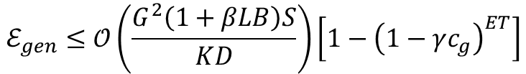

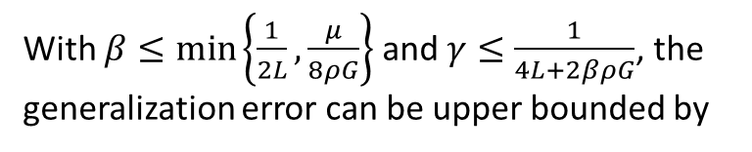
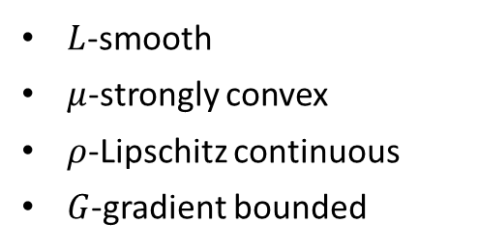
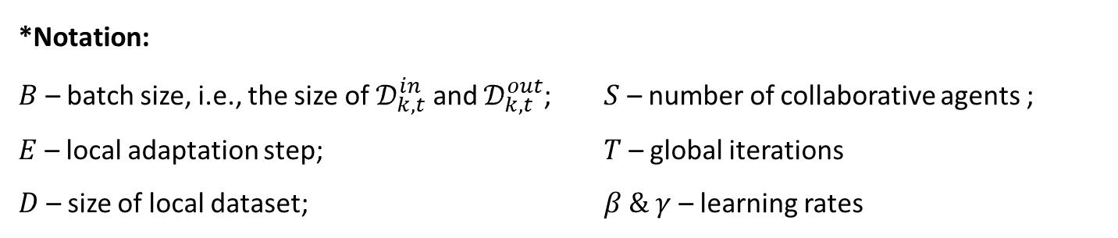

Theoretical Results
Upper Bound of Generalization Error
Assumptions
With $β≤min\left\{\frac{1}{2L},\frac{μ}{8ρG}\right\}$ and $γ≤\frac{1}{4L+2βρG}$, the generalization error can be upper bounded by
Loss function $ℒ\left(w;x,y\right)$ satisfies
$L$-smooth
$μ$-strongly convex
$ρ$-Lipschitz continuous
$G$-gradient bounded
$$ℰ_{gen}≤𝒪\left(\frac{G^{2}\left(1+βLB\right)S}{KD}\right)\left[1−{\left(1−γc_{g}\right)}^{ET}\right]$$
$$c_{g}=\frac{2μ\left(2L+ρβG\right)}{16\left(2L+ρβG\right)+μ}$$
*Notation:
$B$ – batch size, i.e., the size of $𝒟_{k,t}^{in}$ and $𝒟_{k,t}^{out}$; $S$ – number of collaborative agents ;
$E$ – local adaptation step; $T$ – global iterations
$D$ – size of local dataset; $β \& γ$ – learning rates
Notes:
We first present the upper bound of generalization error. It’s a asymptotic bound regarding the number of iteration rounds and local adaptation steps.

Slide 18
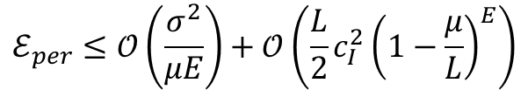

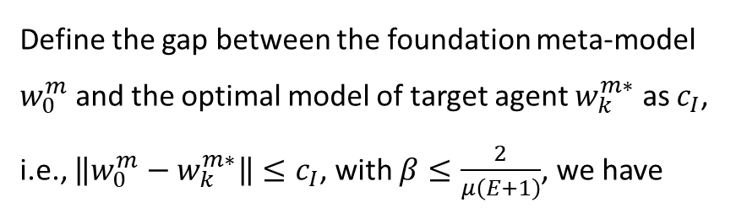


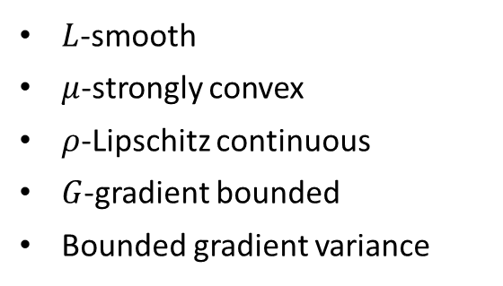
Theoretical Results
Assumptions
Upper Bound of Personalization Error
Loss function $ℒ\left(w;x,y\right)$ satisfies
Define the gap between the foundation meta-model $w_{0}^{m}$ and the optimal model of target agent $w_{k}^{m∗}$ as $c_{I}$, i.e., $\left\|w_{0}^{m}−w_{k}^{m∗}\right\|≤c_{I}$, with $β≤\frac{2}{μ\left(E+1\right)}$, we have
$L$-smooth
$μ$-strongly convex
$ρ$-Lipschitz continuous
$G$-gradient bounded
Bounded gradient variance
$$ℰ_{per}≤𝒪\left(\frac{σ^{2}}{μE}\right)+𝒪\left(\frac{L}{2}c_{I}^{2}{\left(1−\frac{μ}{L}\right)}^{E}\right)$$
$$𝔼\left[{\left\|∇ℒ\left(w;x,y\right)−𝔼\left[∇ℒ\left(w;x,y\right)\right]\right\|}^{2}\right]≤σ^{2}$$
Discussion of tradeoff
Global collaboration view
Iterations $T$, collaborative agents $S$
Better Generalization
Better Personalization
Small
Large
Adaptation steps $E$, step size $β$
Local adaptation view
Notes:
We then present the upper bound of personalization error. It consists of two terms, the first term is adaptation error that decays at a rate of one over E, reflecting improved convergence towards the local optimum.
The second term denotes residual initial deviation, which diminishes exponentially. The initial model discrepancy is progressively corrected.
We can observe a fundamental tradeoff between generalization and personalization, which is controlled by Iterations, collaborative agents, Adaptation steps, and step size.

Slide 19
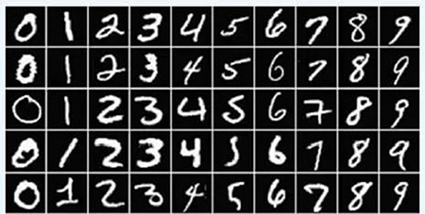
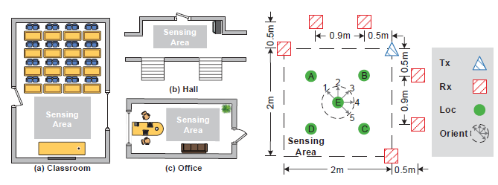
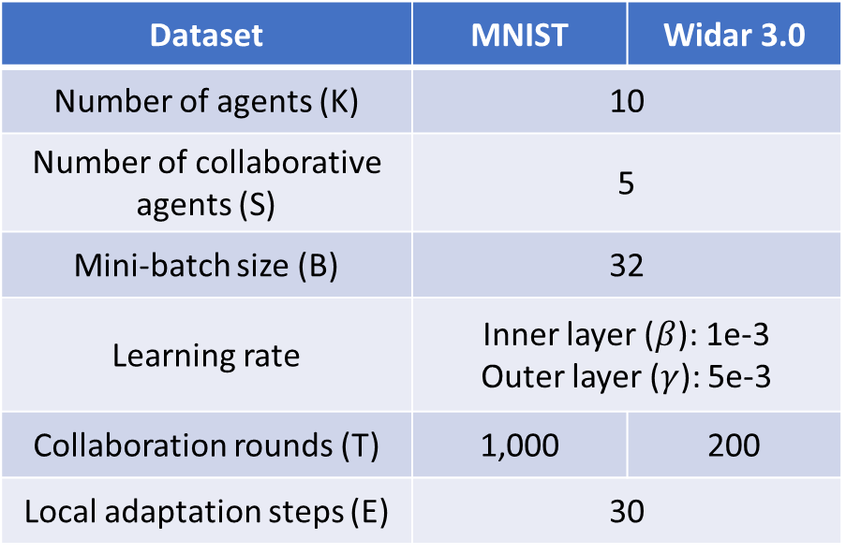
Experiment Setup
Datasets
Default Parameters
MNIST^{[1]}
  Handwritten digit image dataset where each image consists of 28×28 gray-scale pixels
Dataset | MNIST | Widar 3.0
Number of agents (K) | 10
Number of collaborative agents (S) | 5
Mini-batch size (B) | 32
Learning rate | Inner layer ($β$): 1e-3 Outer layer ($γ$): 5e-3
Collaboration rounds (T) | 1,000 | 200
Local adaptation steps (E) | 30
Widar 3.0^{[2]}
  RF-based human gesture recognition dataset recorded by 6 distributed Wi-Fi receivers
[1] Y. LeCun, “The mnist database of handwritten digits,” http://yann. lecun.com/exdb/mnist/, 1998.
[2] Y. Zheng, Y. Zhang, K. Qian, G. Zhang, Y. Liu, C. Wu, and Z. Yang, “Zero-effort cross-domain gesture recognition with wi-fi,” in ACM MobiSys, Seoul, Korea, Jun. 2019.
Notes:
We conduct the experiments using two real-world datasets. Both datasets are for classification tasks, and one of them is the well-known MNIST, and another one is Widar 3.0, it’s a RF-based human gesture recognition dataset recorded by 6 distributed Wi-Fi receivers
The detailed setup is shown in the right table.

Slide 20
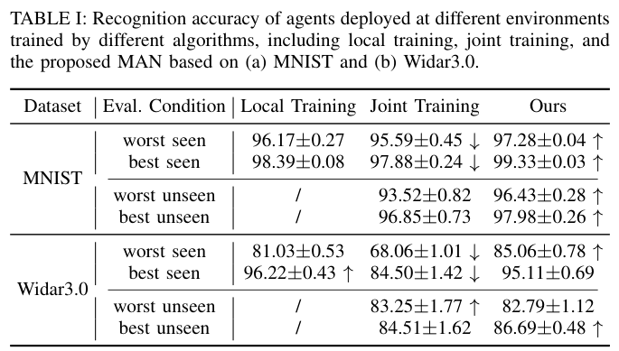
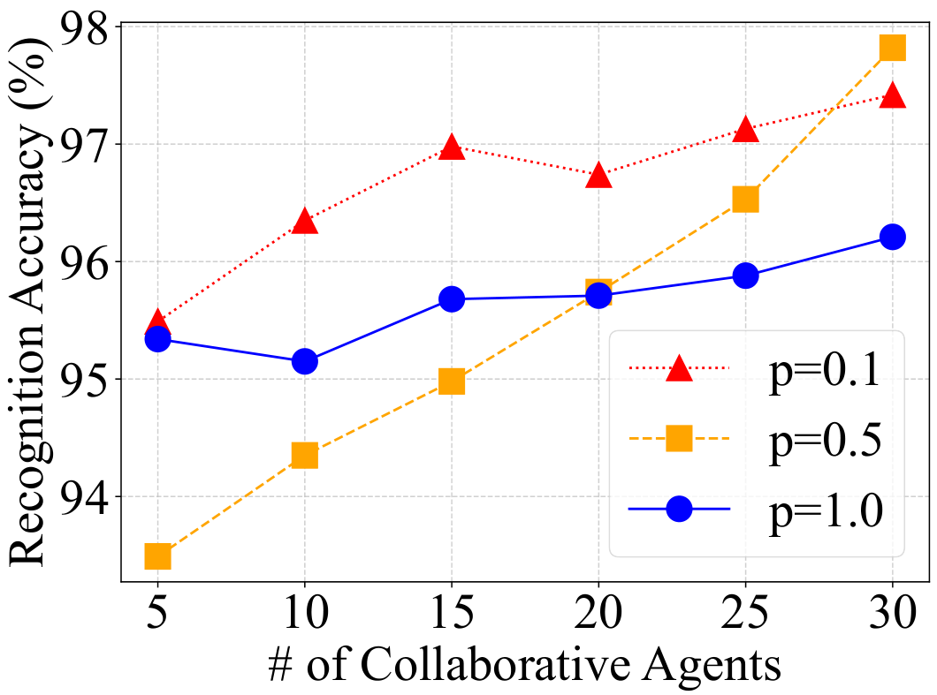

Performance of MAN
worst
best
10 E-Agents
5 E-Agents
# of agents
* $p$ denotes the non-i.i.d. degree
personalization performance
generalization performance
Observation 2
Observation 1
Accuracy always improves as the number of agents increases.
This improvement is most pronounced in moderately heterogeneous scenarios.
The proposed MAN demonstrates superior performance in both personalization and generalization, achieving a favorable tradeoff.
Notes:
We first present a comparative evaluation of different agent collaboration approaches for the recognition task on MNIST and Widar3.0 datasets. The proposed MAN demonstrates superior performance in both personalization and generalization, achieving a favorable tradeoff.
We compare the converged recognition accuracy when the foundation model is trained with varying numbers of collaborative agents under different non-i.i.d. conditions. Larger p means more iid. We observe that accuracy always improves as the number of agents increases. And this improvement is most pronounced in moderately heterogeneous scenarios.

Slide 21
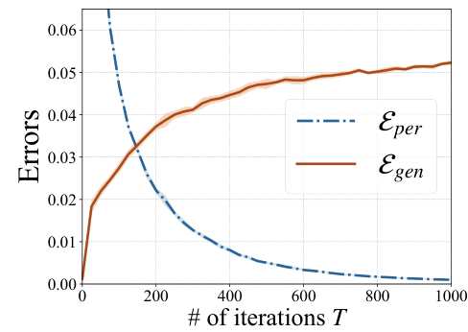
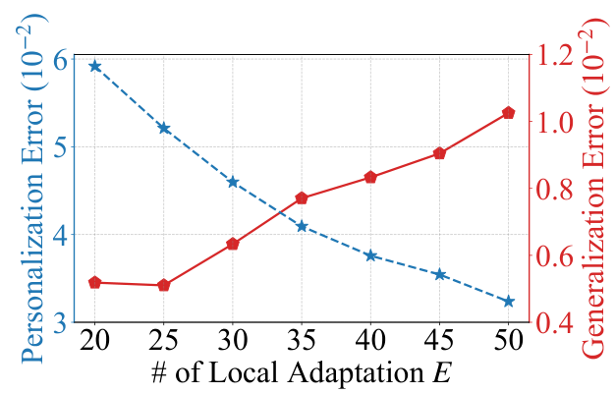
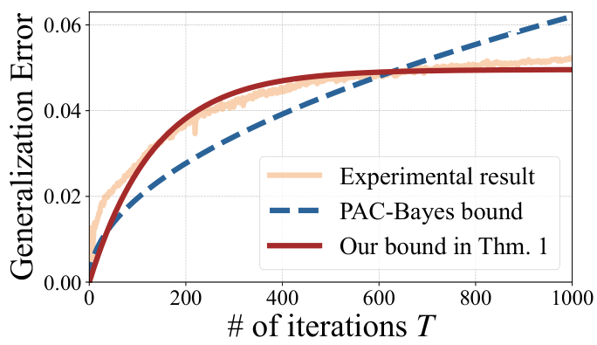
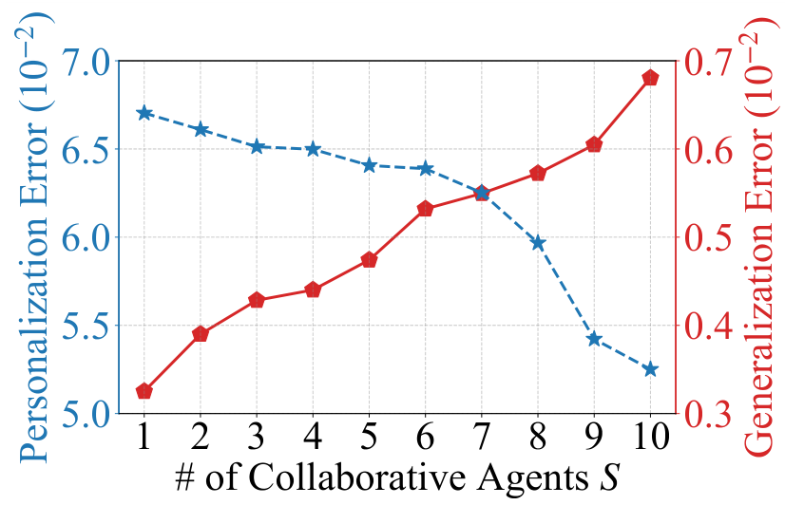
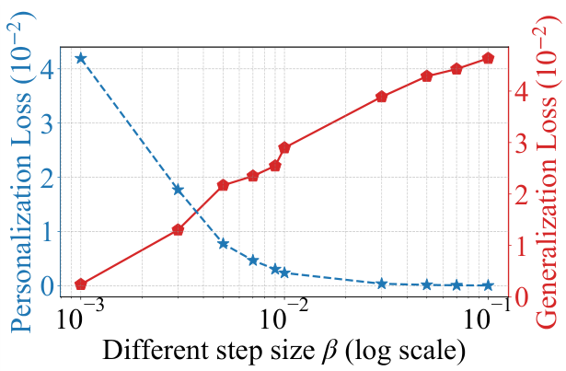
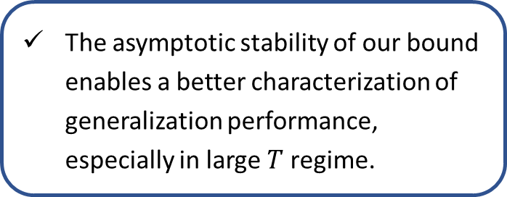
Verification of Theoretical Results
Global collaboration view
Local Adaptation view
Theoretical bounds for generalization
Observation 4
Observation 3
The asymptotic stability of our bound enables a better characterization of generalization performance, especially in large $T$ regime.
Our theoretical results hold generally.
The tradeoff can only be optimized but not entirely eliminated.
Notes:
We validate our theoretical results on the tradeoff between local personalization and global generalization. We observe that Our theoretical results hold generally. The tradeoff can only be optimized but not entirely eliminated.
Finally, we compare our derived theoretical bounds for generalization with existing solutions. We observe that the asymptotic stability of our bound enables a better characterization of generalization performance, especially in large T regime.

Slide 22
Outline
Background and Motivation
System Model & Problem Formulation
Workflow of MAN
Theoretical & Experimental Results
Conclusions
Notes:
Finally, here are conclusions.

Slide 23
Conclusions
Proposed a meta learning-based agentic AI networking (MAN) framework to efficiently balance generalization and personalization in multi-agent networks
Derived asymptotic theoretical bounds on generalization and personalization errors respectively
Conducted extensive measurements on real-world dataset to verify the theoretical results

Slide 24
Thank You!
For more information, please contact:
Xubo Li
(xuboli@hust.edu.cn)
Yong Xiao
（yongxiao@hust.edu.cn）
Notes:
That’ s all! Thanks for your listening.

